Slide 1
Unit-II Test Planning and Management
JSPM’s BSIOTR, Wagholi Pune
Computer Engineering Department
Presented by:- Asst.Prof. Adsure Sharad

Slide 2
Content
Review of Fundamentals of Software Testing, Testing during development life cycle
Requirement Traceability matrix, essentials, Work bench
Important Features of Testing Process, Misconceptions, Principles of Software Testing, salient and policy of Software testing, Test Strategy, Test Planning,
Testing Process and number of defects found, Test teem efficiency
Mutation testing, challenges, test team approach
Process problem faced, Cost aspect, establishing testing policy, methods, structured approach
categories of defect, Defect/ error/ mistake in software
Developing Test Strategy and Plan, Testing process, Attitude towards testing, approaches, challenges, Raising management awareness for testing,
skills required by tester.

Slide 3
Fundamentals of S/W Testing
Definition:- “Software testing is a set of processes aimed at investigating, evaluating and ascertaining the completeness and quality of computer software”. Software testing ensures the compliance of a software product in relation with regulatory, business, technical, functional and user requirements
According to ANSI/IEEE 1059 standard – A process of analyzing a software item to detect the differences between existing and required conditions (i.e., defects) and to evaluate the features of the software item.
The process or method of finding error/s in a software application or program so that the application functions according to the end user's requirement is called software testing.
It is the process of exercising or evaluating a system or system component by manual or automated means to verify that it satisfies specified requirements – [IEEE 83a]
Process: Sequence of steps performed for a given purpose [IEEE]
Software Process: A set of activities, methods, practices and transformations that people use to develop & maintain software and associated products [SEI-CMM]

Slide 4
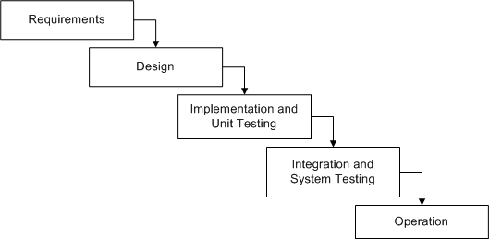
Waterfall Model for Testing
Advantages of Waterfall Model
Disadvantages of Waterfall Model
Simple and easy to use.
Easy to manage due to the rigidity of the model–each phase has specific deliverables and a review process.
Phases are processed and completed one at a time.
Works well for smaller projects where requirements are very well understood.
Adjusting scope during the life cycle can kill a project
No working software is produced until late during the life cycle.
High amounts of risk and uncertainty.
Poor model for complex and object-oriented projects.
Poor model where requirements are at a moderate to high risk of changing.

Slide 5
W-Model for Testing
Advantages of W - Model
Simple and easy to use.
Each phase has specific deliverables.
Higher chance of success over the waterfall model due to the development of test plans early on during the life cycle.
Works well for small projects where requirements are easily understood.
Disadvantages of W - Model
Very rigid, like the waterfall model.
Little flexibility and adjusting scope is difficult and expensive.
Software is developed during the implementation phase, so no early prototypes of the software are produced.
Model doesn’t provide a clear path for problems found during testing phases.

Slide 6
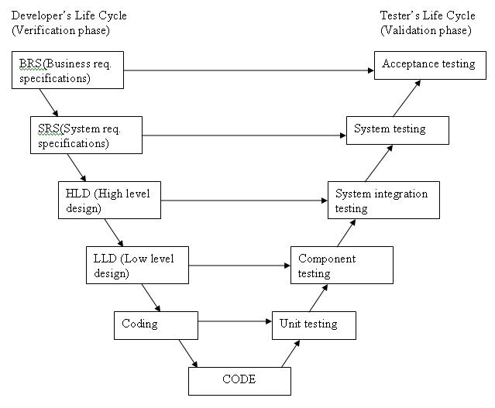
Testing during development life cycle

Slide 7
Unit Testing
It is a level of the software testing process where individual units / components of a software/system are tested
The purpose is to validate that each unit of the software performs as designed
It is a method by which individual units of source code are tested to determine if they are fit for use
Benefits :-
1. Early detection of software defects
2. Provides scope for change or update
3. Simplifies integration testing
4. Proper documentation can maintain
5. Contributes in good design of overall software

Slide 8
Integration and System Testing
Testing the interaction between the modules and interaction with other systems externally is called integration testing
Integration testing starts when two of the product components are available and ends when all component interfaces have been tested
Integration testing is both a type of testing and a phase of testing
The testing conducted on the complete integrated products and solutions to evaluate system compliance with specified requirements on functional and nonfunctional aspects is called system testing
It is the first level of software testing where the application is tested as a whole

Slide 9
Acceptance Testing
Acceptance testing is done by the customer or by the representative of the customer to check whether the product is ready for use in the real-life environment
Following test cases can be included for acceptance testing
End-to-end functionality verification
Domain tests
User scenario tests
Basic sanity tests
New functionality
A few non-functional tests
Tests pertaining to legal obligations and service level agreements
Acceptance test data

Slide 10
Requirements Traceability Matrix (RTM)
A Traceability Matrix is a document that co-relates any two-baseline documents that require a many-to-many relationship to check the completeness of the relationship.
It is used to track the requirements and to check the current project requirements are met.
RTM captures all requirements proposed by the client or software development team and their traceability in a single document delivered at the conclusion of the life-cycle.
Requirement Traceability Matrix – Parameters include
Requirement ID
Risks | Integration test cases
Requirement Type and Description | System test cases
Trace to design specification Unit test cases | User acceptance test cases

Slide 11
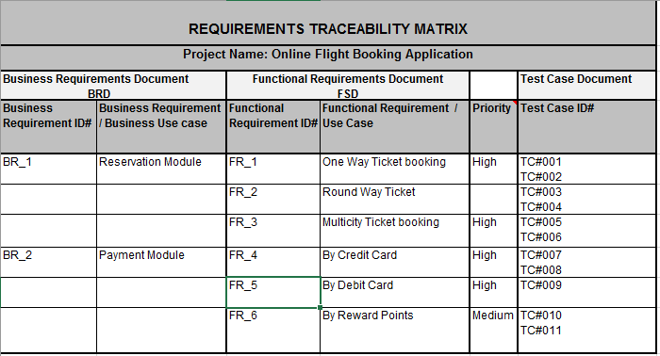
RTM Essentials
It ensure requirement traceability and generate the actual requirement traceability document.
organizations might use Excel spreadsheets to keep a table of requirements, despite this being extremely difficult to maintain manually.
In more complicated systems, the traceability matrix may include references to additional documentation, including user requirements, risk assessments, etc.

Slide 12
Workbench of Testing
A Workbench is a method of documenting how a particular activity must be fulfilled.
A workbench is referred to a stages, steps, and assignments while performing certain activities in testing.
A workbench gives you an opportunity to execute any one task with appropriate software testing.
Requirement phase:- The input data – the requirements of clients; we perform a task – writing a document with the customer’s requirements, we check the suitability of a document to all needs of client, and receive the output – requirement document.
Design phase:- The input data – the requirement document, we execute the preparing a technical document; review/test is performed to see if the design document is technically right and transfers all the requirements in the requirement document, and receive a technical document.
Execution phase:- It is the actual performance of the project. The input data – the technical document; the performance is nothing but realization/ coding according to the technical document, and the output data – the source code.

Slide 13
Workbench Phases
Testing phase workbench It is the stage of software testing. The input data – the source code which is required testing; the realization – implementation of the test case and the output – the results of software testing.
Distribution phase There are two inputs for this step – the source code which requires of customers and the source code with the results of testing. The output of this project is the product which is ready for use.
Maintenance phase The input – the results of distribution, execution – execution of the last customer requests, the running regression software testing after every changed customer request, and the output is a new release.

Slide 14
Important Features of Testing Process
Testing is destructive process, But its constructive destruction
Testing needs positive approach with consideration that there is defect
If test dose not detect defect present in system, then its unsuccessful test
Root cause analysis and corrective/preventive actions must be mentioned.
Performing regression testing when defect are resolved by development team
Proper test helps to improve over all product.

Slide 15
Misconceptions about Testing and Defects
Testers can test the quality of product at end of development process.
Defect found in testing are blamed on developers .
Defect found by customers are blamed on testers.
Complete testing is done
Zero defect software (product) creation.
Tester can find all defects in limited period
Testing is manual process, Automation involve optionally
Testing process is simple than development step.
Testing required less efforts
Quality assurance is secondary based on brand value.

Slide 16
Generalized Principles of Software testing,
Programmers/ team must avoid testing their own works products
Thoroughly inspect results of each test case has to found to identify weaker area in software
Defects indicates process failure
Initiate actions for correction, corrective action & preventive action.
Salient features of good Software testing
Capture user requirements
Capturing user needs
Design objective must define properly
User interface simple and easy to understand
Internal Structure complex but simple to understand
Execution of code reduce risk of failure

Slide 17
Test Policies
Test policies are generally defined by senior management try to cover all aspects of testing.
It decides framework of testing towards customer satisfaction.
Testing will performed against TQM principles to find and fulfill customer centric approach
Test Strategy or Approach
Globally, there is unique test policy decided by management but it can varies as per customer, Deadline, Product, Project etc.
Definition of coverage is defined for testing (Functional, requirements and features for different products, Customer and project)
Level of testing must monitored and maintained (unit to acceptance testing)
How much testing manually and when to automate has been planned and executed.
Number of developer and testers are assigned in proportion.

Slide 18
Test Planning
Test planning is first activity of test team
Test plan are defined throughout SDLC
Test plan must be realistic and talk about limitations and constraints in system
Plan testing efforts adequately with assumption that defects are exists in software
Successful tester founds defect in systems not appreciates developer
Testing dose not completed at end of development cycle,
(plan for maintenance)
Verification(do-right thing) and validation(right-thing do) must done at each phase of testing.

Slide 19
What is a difference between Test plan and Test strategy?
The test plan is a term and a deliverable. The test plan is a document that lists all the activities in a QA project, schedules them, defines the scope of the project, roles & responsibilities, risks, entry & exit criteria, test objective and anything else that you can think of. The test plan is as I like to call a ‘super document’ that lists everything there is to know and need.
This is also a deliverable and also a document at that. Test strategy outlines the testing approach and everything else that surrounds it. It is different from the test plan, in the sense that a Test strategy is only a subset of the test plan. It is a hardcore test document that is to an extent generic and static.
There is also an argument about at what levels test strategy or plan is used- but I really do not see any discerning difference
Example: Test plan gives the information of who is going to test at what time. For example, Module 1 is going to be tested by “X tester”. If tester Y replaces X for some reason, the test plan has to be updated.
On the contrary, a test strategy is going to have details like – “Individual modules are to be tested by test team members. “ In this case, it does not matter who is testing it- so it’s generic and the change in the team member does not have to be updated, keeping it static.

Slide 20
What is a difference between Test case & Test script?
In my opinion, these two terms can be used interchangeably. Yes, I am saying there is no difference. The test case is a sequence of steps that help us perform a certain test on the application. The test script is the same thing.
Now, there is one school of thought that test case is a term used in the manual testing environment and test script is used in an automation environment. This is partly true, because of the comfort level of the testers in the respective fields and also on how the tools refer to the tests (some call test scripts and some call them to test cases). So in effect, test script and test case both are steps to be performed on an application to validate its functionality whether manually or through automation.

Slide 21
Difference between Test scenario & Test condition
This is a one line pointer that testers create as an initial, transitional step into the test design phase. This is mostly a one-line definition of “What” we are going to test with respect to a certain feature. Usually, test scenarios are an input for the creation of test cases. In agile projects, Test scenarios are the only test design outputs and no test cases are written following these. A test scenario might result in multiple tests.
Examples test scenarios:
1. Validate if a new country can be added by the Admin 2. Validate if an existing country can be deleted by the admin
Example test condition:
In the above example, if we were to test the scenario 1, we can test the following conditions:
1. Enter the country name as “India”(valid )and check for the addition of the country

Slide 22
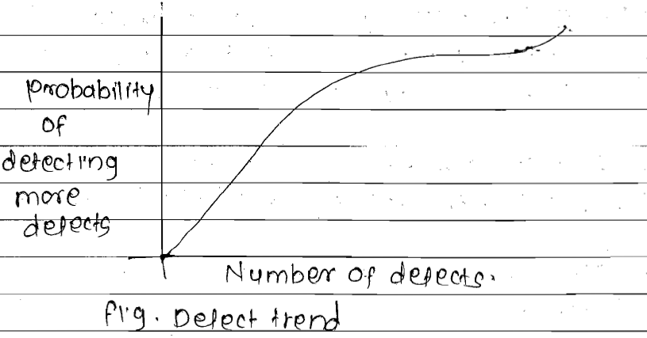
Testing Process and number of defects found in testing
In real time, As we find more defects, there is probability of finding some more defects. Governed by teams defect finding ability.
Figure :- defect trend
As tester assures one defect may leads multiple defects and count of defect will increasing

Slide 23
Test team efficiency
It’s a defect finding rate of particular test team
More the efficient team, Less the defects found in system by customer, As these are resolved by developer in iteration of product/service.
Every test manager must aware of test team efficiency which should tends towards 100%
Ex. 90% means, 500 defects are reported by team still there exists 50 more defects possible, 95% still 25 more. 100 no more defects(practically not achievable).
Efficiency can calculate using old success rates.

Slide 24
Mutation testing
This testing use to check capability of test program to find defects
This also known as test case efficiency.
If original program is changed(due to any reason) and some defects are added in system called mutant of original program and process termed as mutation.

Slide 25
Challenges in testing
Challenges associated with developer team, Customer needs, Management perspective
Requirements are not clear, complete, consistent, measurable and testable
Requirements are wrongly documented & inspected by business & system analyst
Code logic may difficult to capture
Error handling may be difficult to capture
More bugs found in system needs no of iterations
Bad architecture of s/w can not implement good requirement statement.
Testing is consider as negative activity

Slide 26
Test team & approaches
Type of organization & Type of product developed to be tested define test team.
There may or may not be separate testing team for each product to be developed.
Developer become testers –Small size team
Independent testing team- Assigns test manager
Domain experts doing software testing –System and acceptance testing
Test team reporting development manager-Most common test team approach

Slide 27
Location of test team in org.
Location of test team in an organization
Independent test team Adv: test team is not under delivery pressure . can present independent view @ product. expert guidance and mentoring is available. Disadv: There is always us vs we mentality Tester may not get good understanding of development process. Management inclination toward anyone team.
2. Team reporting to development manager Adv: Better coordination between development & test team. Test team involvement from start. Tester may get good understanding of development. Disadv: Expert advice in form of test manager may not available. Sometimes development manager may inclined towards development team

Slide 28
Developer becomes tester
Adv: Do not need knowledge transfer They can have better understanding about design and coding For automation some development knowledge can be useful. Its less costly

Slide 29
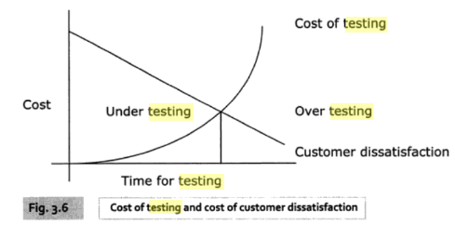
Process problem faced in Testing
Defects are introduce in software due to incorrect processes, The basic constituents (part) of processes are :-
People :- user-specifying requirements, Business analyst-document requirements, Test manager define test plan, tester define test case etc.
Material:- Requirement docs, development standards, guidelines must provide properly
Machines :-Simulators, real time objects defined
Methods:- Test planning, defining, test data may not proper.
Economics of testing:-Customer dissatisfaction inversely proportional to testing efforts
Fig 3.6 taken from M.G.Limaye software testing book

Slide 30
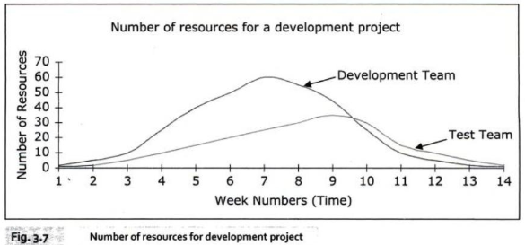
Cost aspect in Testing
Cost of quality includes cost of appraisal, prevention and failure cost of product/service
Testing is costly to organization, so it try to keep as minimum as possible
As per economics of testing cost has to manage
Cost include :-Capture requirements, Conduct analysis, ask queries, Design test cases high and low level, write code, automation test tool, create final product and maintain.
Fig 3.7 taken from M.G.Limaye software testing book

Slide 31
Structured approach for testing
Establish testing policies
Use standard methods
Four types of wastes are involved in structured approach
Waste in wrong development
Waste in testing to detect defects
Wastage as wrong specification, design, codes and documents must be replaced with correct specification, design, codes and documents
Wastage as system must be retested to ensure that the correction are correct

Slide 32
Categories of Defect
On basis of requirement/Design specification
Types of defect
Wrongly implemented specification are relate to the specification as understood by developers
Missing specification, Present in statement but absent in final product
Features not supported by specification but present in product represent something extra.
Root causes of defect
Wrong requirements given by user
Business analyst interpreted customer need
System design architecture doesn't understand requirement properly
Error as lack of skill in understand design
Data entry error caused by user while using product
Error in testing false call/ failure
Mistake in error correction

Slide 33
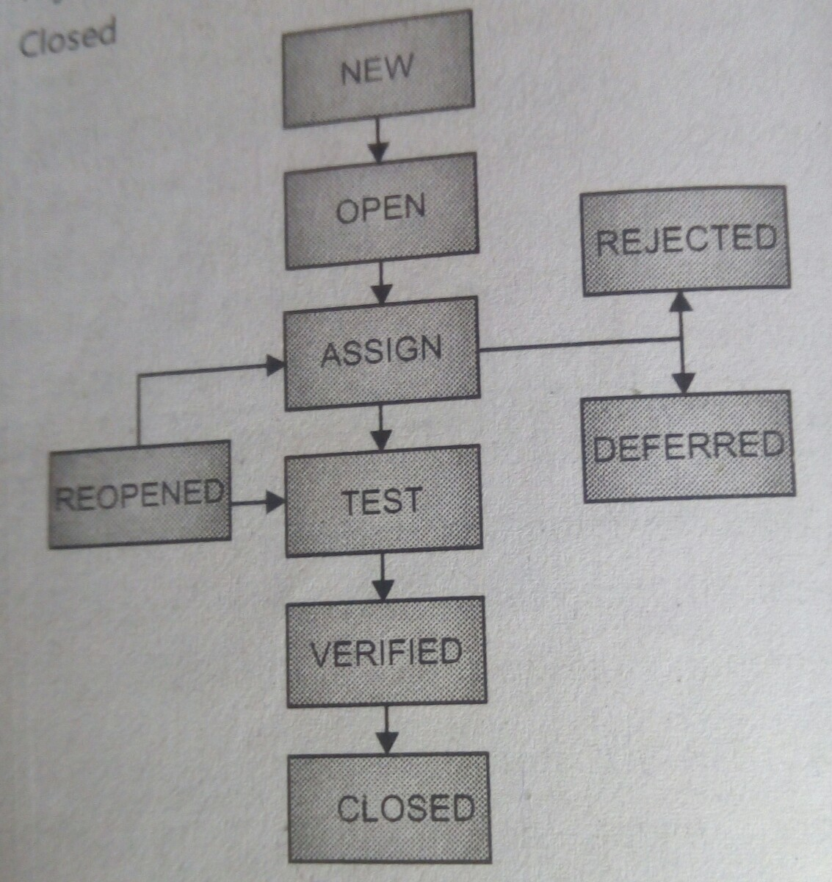
Stages of bugs/ bug life cycle

Slide 34
Developing Test Strategy and Plan
Process of developing test strategy goes through following stages
Select and rank test factor for given application
Identify system development phases and related test factor
Identify associated risk with each selected test factor, if that was not achieved
Identify phase in which risk of meeting test factor need to be addressed
Designing or defining of test methodology may take following routs
Acquires and study test strategy as designed earlier
Determining the type of development project being executed
Determining the type of s/w system being made.
Identify the tactical risk related to development.
Determine when testing must occurs during life cycle.

Slide 35
Testing Process
These process may vary from org. to org. or project to project.
Following are few milestones commonly used by org.
Determine test policy
Determining test strategy
Prepare test plan
Establishes test objectives
Design test cases
Writing and review test cases
Creating of test bed
Executing test cases
Test result
Test result analysis
Perform retesting
Root cause analysis and corrective or preventive actions.

Slide 36
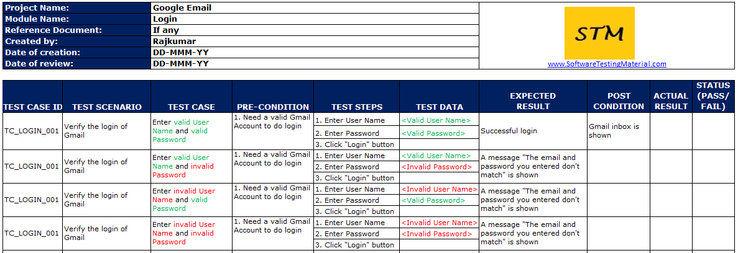
Sample Test case
,
, methods,,
categories of defect, Defect/ error/ mistake in software,
Developing Test Strategy and Plan,
Testing process,
Attitude towards testing, approaches, challenges,
Raising management awareness for testing,
skills required by tester.

Slide 37
Attitude towards Testing
When there is new member in team
We takes pride what we have developed.
Conflict between developer and testing.

Slide 38
Part 3: Test methodology / approaches
The technique of testing without having any knowledge of the interior workings of the application is called black-box testing. The tester is oblivious to the system architecture and does not have access to the source code. Typically, while performing a black-box test, a tester will interact with the system's user interface by providing inputs and examining outputs without knowing how and where the inputs are worked upon.
Black box testing advantages | Black box testing Disadvantages
Well suited and efficient for large code segments. | Limited coverage, since only a selected number of test scenarios is actually performed.
Code access is not required. | Inefficient testing, due to the fact that the tester only has limited knowledge about an application.
Clearly separates user's perspective from the developer's perspective through visibly defined roles. | Blind coverage, since the tester cannot target specific code segments or errorprone areas.
Large numbers of moderately skilled testers can test the application with no knowledge of implementation, programming language, or operating systems. | The test cases are difficult to design.
White box testing

Slide 39
Conti…
White-box testing is the detailed investigation of internal logic and structure of the code. White-box testing is also called glass testing/open-box testing. In order to perform white-box testing on an application, a tester needs to know the internal workings of the code.
The tester needs to have a look inside the source code and find out which unit/chunk of the code is behaving inappropriately.
White Box Testing Advantages | White Box Testing Disadvantages
As the tester has knowledge of the source code, it becomes very easy to find out which type of data can help in testing the application effectively. | Due to the fact that a skilled tester is needed to perform white-box testing, the costs are increased.
It helps in optimizing the code. | Sometimes it is impossible to look into every nook and corner to find out hidden errors that may create problems, as many paths will go untested.
Extra lines of code can be removed which can bring in hidden defects. | It is difficult to maintain white-box testing, as it requires specialized tools like code analyzers and debugging tools.
Due to the tester's knowledge about the code, maximum coverage is attained during test scenario writing.

Slide 40
Grey-box testing is a technique to test the application with having a limited knowledge of the internal workings of an application. In software testing, the phrase the more you know, the better carries a lot of weight while testing an application. Mastering the domain of a system always gives the tester an edge over someone with limited domain knowledge. Unlike black-box testing, where the tester only tests the application's user interface; in grey-box testing, the tester has access to design documents and the database.
Grey Box Testing Advantages | Grey Box Testing Disadvantages
Offers combined benefits of black-box and white-box testing wherever possible. | Since the access to source code is not available, the ability to go over the code and test coverage is limited.
Grey box testers don't rely on the source code; instead they rely on interface definition and functional specifications. | The tests can be redundant if the software designer has already run a test case.
Based on the limited information available, a grey-box tester can design excellent test scenarios especially around communication protocols and data type handling. | Testing every possible input stream is unrealistic because it would take an unreasonable amount of time; therefore, many program paths will go untested.
The test is done from the point of view of the user and not the designer.

Slide 41
Skills required by tester
General Skills: Written and verbal presentation, Effective listening, Observations
Testing Skill: Concept of testing, Level of Testing, Techniques for verification and validation, selection and using of testing tool, knowledge of testing stand.
Thinking of client
Creativity and Innovation
Improvement
Know the priorities

Slide 42
Different stages of SDLC with STLC
Stage-1 Requirement Gathering
DA: Defining requirements to establish specifications is the first step in the development of software.
TA: Reviewing the requirements e.g the requirements should not have ambiguous words like (may or may not). It should be clear and concise.

Slide 43
Different stages of SDLC with STLC
Stage-2 Functional Specification
DA: It describes the product’s behaviors as seen by an external observer, and contains the technical information and data needed for the design. The functional specification defines what the functionality will be
TA: In order to make the functional specifications accurate we have review our functional specifications.
Stage-3 Design
DA: The software specifications are transformed in to design models that describe the details of the data structures, system architecture, interface and the components.
TA: Each design product is reviewed for quality before moving the next phase of the software development.

Slide 44
Different stages of SDLC with STLC
Stage-4 Code
DA: In this phase the designs are translated into code.
TA: Code review is a process of verifying the source code. Code review is done the find and fix the defects that are overlooked in the initial development phase, to improve overall quality of code.
Stage-5 Building Software
DA: In this phase we build different software units and integrate them one by one to build single software.
TA: Unit testing & Integration testing

Slide 45
Different stages of SDLC with STLC
Stage-6 Building system
DA: After the software has been build we have the whole system considering all the non-functional requirements like installation procedure, configuration etc.
TA: System testing & Acceptance testing
Stage-7 Release for use
After the whole product has been developed and the required level of quality has been achieved and the software is release for the actual use of the customers.

Slide 46
Testing Techniques
Testing Techniques
Verification
Reviews Walkthrough Inspection
Validating
White Box testing Black Box testing

